Slide 1
Hypertension and Alzheimer’s disease

Slide 2
1.
Table 1

Slide 3
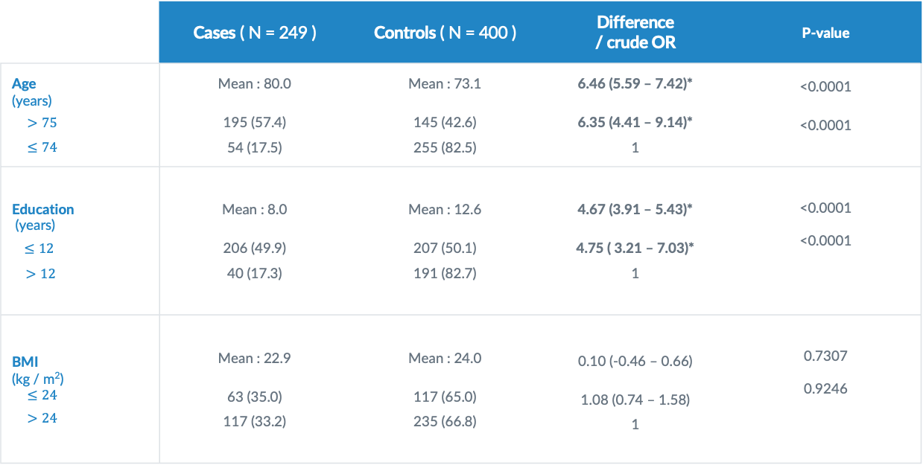
Table 1 : continuous variables
 | Cases ( N = 249 ) | Controls ( N = 400 ) | Difference / crude OR | P-value
Age (years) $>75$ $≤74$ | Mean : 80.0 195 (57.4) 54 (17.5) | Mean : 73.1 145 (42.6) 255 (82.5) | 6.46 (5.59 – 7.42)* 6.35 (4.41 – 9.14)* 1 | <0.0001 <0.0001
Education (years) $≤12$ $>12$ | Mean : 8.0 206 (49.9) 40 (17.3) | Mean : 12.6 207 (50.1) 191 (82.7) | 4.67 (3.91 – 5.43)* 4.75 ( 3.21 – 7.03)* 1 | <0.0001 <0.0001
BMI (kg / m²) $$≤24$$ $>24$ | Mean : 22.9 63 (35.0) 117 (33.2) | Mean : 24.0 117 (65.0) 235 (66.8) | 0.10 (-0.46 – 0.66) 1.08 (0.74 – 1.58) 1 | 0.7307 0.9246

Slide 4
Table 1 : basic
 | Cases ( N = 249 ) | Controls ( N = 400 ) | Crude OR | P-value
Sex Female Male | 155 (42.6) 94 (33.0) | 209 (57.4) 191 (67.0) | 1.51 (1.09 – 2.08)* 1 | 0.0126
APOE e4 status Carrier Non-carrier | 97 (61.8) 142 (31.4) | 60 ( 38.2) 311 (68.6) | 3.54 (2.43 – 5.17)* 1 | <0.0001

Slide 5
Table 1 : habits
 | Cases ( N = 249 ) | Controls ( N = 400 ) | Crude OR | P-value
Alcohol Yes No | 32 (44.4) 217 (37.7) | 40 (55.6) 359 (62.3) | 1.32 (0.81 – 2.17) 1 | 0.2655
Smoking Yes No | 58 (45.0) 191 (36.8) | 71 (55.0) 328 (63.2) | 1.48 (0.95 – 2.07) 1 | 0.0882
Passive smoking Yes No | 74 (43.0) 147 (33.4) | 98 (57.0) 293 (66.6) | 1.51 (1.05 – 2.16)* 1 | 0.0260

Slide 6
Table 1 : drinks
 | Cases ( N = 249 ) | Controls ( N = 400 ) | Crude OR | P-value
Coffee Yes No | 47 (27.0) 202 (42.6) | 127 (73.0) 272(57.4) | 0.48 (0.34 – 0.73)* 1 | 0.0003
Tea Yes No | 65 (32.2) 184 (41.3) | 137 (67.8) 262 (58.7) | 0.68 (0.48 – 0.96)* 1 | 0.0278

Slide 7
Table 1 : activities
 | Cases | Controls | Crude OR | SATURDAY
Regular physical activity No Yes | 105 (47.5) 144 (33.7) | 116 (52.5) 283 (66.3) | 1.78 (1.28 – 2.48)* 1 | 0.0006
Regular cognitive activity No Yes | 21 (39.6) 228 (38.3) | 32 (60.4) 367 (61.7) | 1.06 (0.59 – 1.88) 1 | 0.8517
Regular social activity No Yes | 173 (47.1) 76 (27.1) | 194 (52.9) 205 (72.9) | 2.41 (1.72 – 3.36)* 1 | <0.0001

Slide 8
Table 1 : chronic condition
 | Cases ( N = 249 ) | Controls ( N = 400 ) | Crude OR | P-value
Diabetes Yes No | 47 (44.8) 202 (37.2) | 58 (55.2) 341 (62.8) | 1.37 (0.90 – 2.09) 1 | 0.1448
Hyperlipidemia Yes No | 42 (25.6) 204 (42.5) | 122 (74.4) 276 (57.5) | 0.47 (0.31 – 0.69)* 1 | <0.0001
Cardiovascular dz Yes No | 55 (31.6) 194 (40.9) | 119 (68.4) 280 (59.1) | 0.67 (0.46 – 0.96)* 1 | 0.0307
Hypertension Yes No | 95 (30.4) 154 (45.0) | 218 (69.6) 181 (55.0) | 0.51 (0.37 – 0.71)* 1 | <0.0001

Slide 9
summary of table 1
Significant crude ORs
Age Sex APOE e4 status
Passive smoking Coffee drinking Tea drinking
Hyperlipidemia Cardiovascular dz Hypertension
Physical activities Social activities
Significant crude ORs > 1 :
Age Sex
Passive smoking APOE e4 status
No physical activities No social activities
Significant crude ORs <1 :
Coffee drinking Tea drinking
Hyperlipidemia Cardiovascular dz
Hypertension

Slide 10
2.
stratification
No hypertension (E) --> AD (DZ)

Slide 11
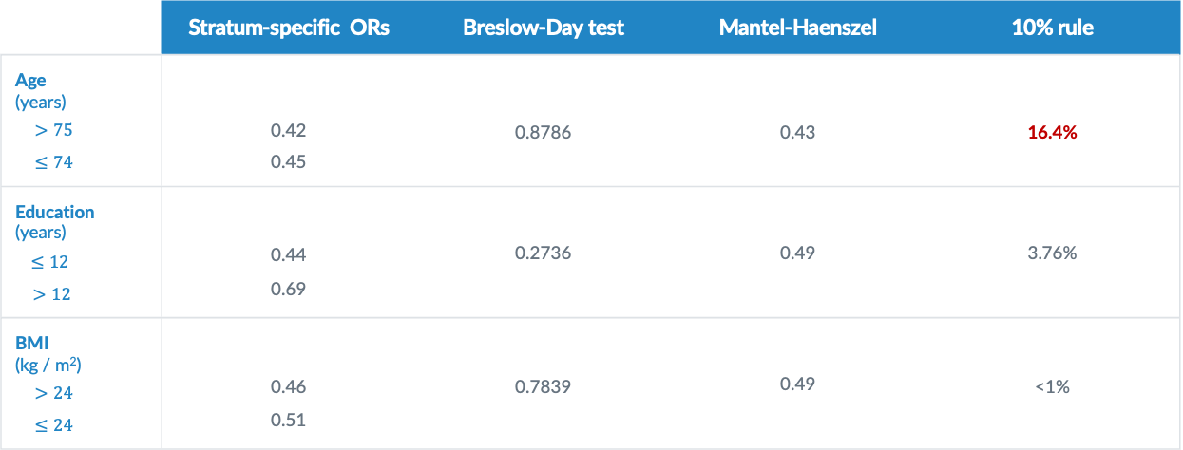
stratification
 | Stratum-specific ORs | Breslow-Day test | Mantel-Haenszel | 10% rule
Age (years) $>75$ $≤74$ | 0.42 0.45 | 0.8786 | 0.43 | 16.4%
Education (years) $≤12$ $>12$ | 0.44 0.69 | 0.2736 | 0.49 | 3.76%
BMI (kg / m²) $>24$ $≤24$ | 0.46 0.51 | 0.7839 | 0.49 | <1%

Slide 12
stratification
 | Stratum-specific ORs | Breslow-Day test | Mantel-Haenszel | 10% rule
Sex Female Male | 0.50 0.49 | 0.9413 | 0.50 | 2.94%
APOE e4 status Carrier Non-carrier | 0.65 0.50 | 0.5045 | 0.54 | 5.03%

Slide 13
stratification
 | Stratum-specific ORs | Breslow-Day test | Mantel-Haenszel | 10% rule
Alcohol Yes No | 0.44 0.52 | 0.7551 | 0.51 | <1%
Smoking Yes No | 0.34 0.57 | 0.2083 | 0.52 | 1.13%
Passive smoking Yes No | 0.28 0.60 | 0.0548 | 0.48 | 5.62%

Slide 14
stratification
 | Stratum-specific ORs | Breslow-Day test | Mantel-Haenszel | 10% rule
Coffee Yes No | 0.52 0.51 | 0.9580 | 0.51 | <1%
Tea Yes No | 0.52 0.49 | 0.8769 | 0.50 | 1.73%

Slide 15
stratification
 | Stratum-specific ORs | Breslow-Day test | Mantel-Haenszel | 10% rule
Diabetes Yes No | 0.39 0.52 | 0.5211 | 0.50 | 2.55%
Hyperlipidemia Yes No | 0.44 0.93 | 0.0667 | 0.52 | 1.63%
Cardiovascular dz Yes No | 0.36 0.61 | 0.1763 | 0.54 | 5.72%

Slide 16
stratification
. | Stratum-specific ORs | Breslow-Day test | Mantel-Haenszel | 10% rule
Regular physical activity No Yes | 0.50 0.50 | 0.9858 | 0.50 | 1.77%
Regular cognitive activity No Yes | 0.26 0.54 | 0.2367 | 0.51 | <1%
Regular social activity No Yes | 0.60 0.37 | 0.1642 | 0.50 | 1.65%

Slide 17
summary of stratification
Confounding factor (by 10% rule)
Age
Significant difference between strata:
Breslow-Day test p-value < 0.05 : none
Breslow-Day test p-value < 0.10 : passive smoking, hyperlipidemia

Slide 18
3.
Model selection

Slide 19
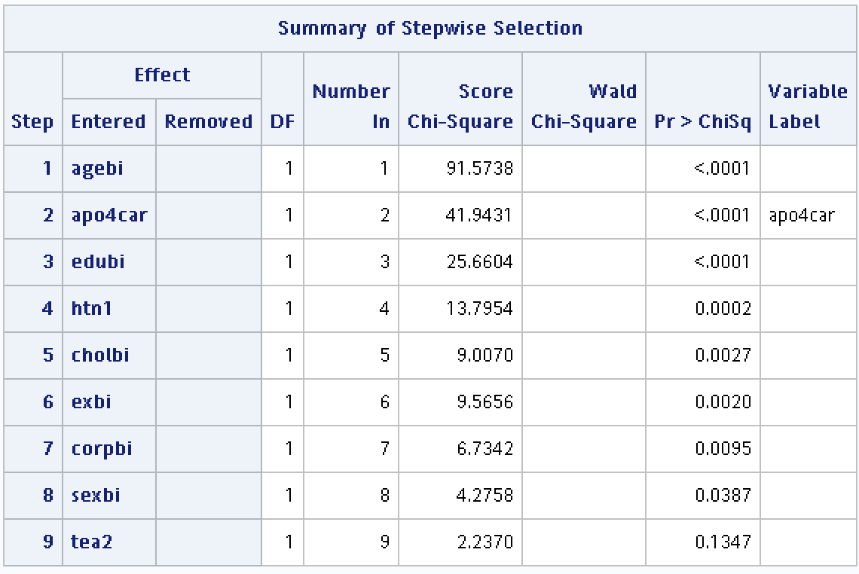
stepwise selection
Stepwise selection：
entry significance level : 0.15
exist significance level : 0.15
Remaining predictor：
hypertension
age
APOE e4 status
hyperlipidemia
education year
physical activities
social activities

Slide 20
interaction term
 | htn | age | sex | eduyr | APOE | exercise | social | chol
htn |  | 0.4637 | 0.8254 | 0.4212 | 0.5749 | 0.9805 | 0.1605 | 0.4441
age |  |  | 0.0074 | 0.7193 | 0.4070 | 0.6890 | 0.9847 | 0.2291
sex |  |  |  | 0.3607 | 0.9925 | 0.0037 | 0.8888 | 0.9103
eduyr |  |  |  |  | 0.0677 | 0.4181 | 0.8610 | 0.6742
APOE |  |  |  |  |  | 0.8347 | 0.3293 | 0.5180
exercise |  |  |  |  |  |  | 0.5869 | 0.1829
social |  |  |  |  |  |  |  | 0.1057
chol

Slide 21
final model
Independent predictors：
hypertension
age
APOE e4 status
hyperlipidemia
education year
physical activities
social activities
Interaction term：
age * sex
sex * exercise

Slide 22
4.
Result

Slide 23
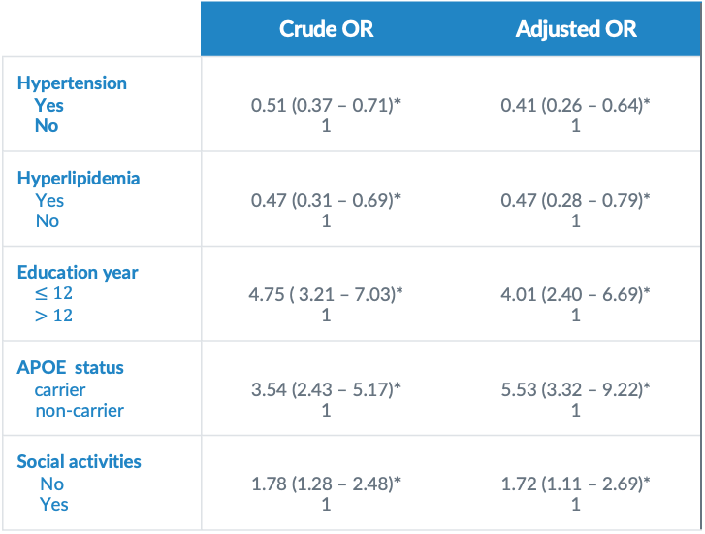
Adjusted ORs
 | Crude OR | Adjusted OR
Hypertension Yes No | 0.51 (0.37 – 0.71)* 1 | 0.41 (0.26 – 0.64)* 1
Hyperlipidemia Yes No | 0.47 (0.31 – 0.69)* 1 | 0.47 (0.28 – 0.79)* 1
Education year $≤12$ $>12$ | 4.75 ( 3.21 – 7.03)* 1 | 4.01 (2.40 – 6.69)* 1
APOE status carrier non-carrier | 3.54 (2.43 – 5.17)* 1 | 5.53 (3.32 – 9.22)* 1
Social activities No Yes | 1.78 (1.28 – 2.48)* 1 | 1.72 (1.11 – 2.69)* 1

Slide 24
5.
Discussion
Let’s start with the first set of slides

Slide 25
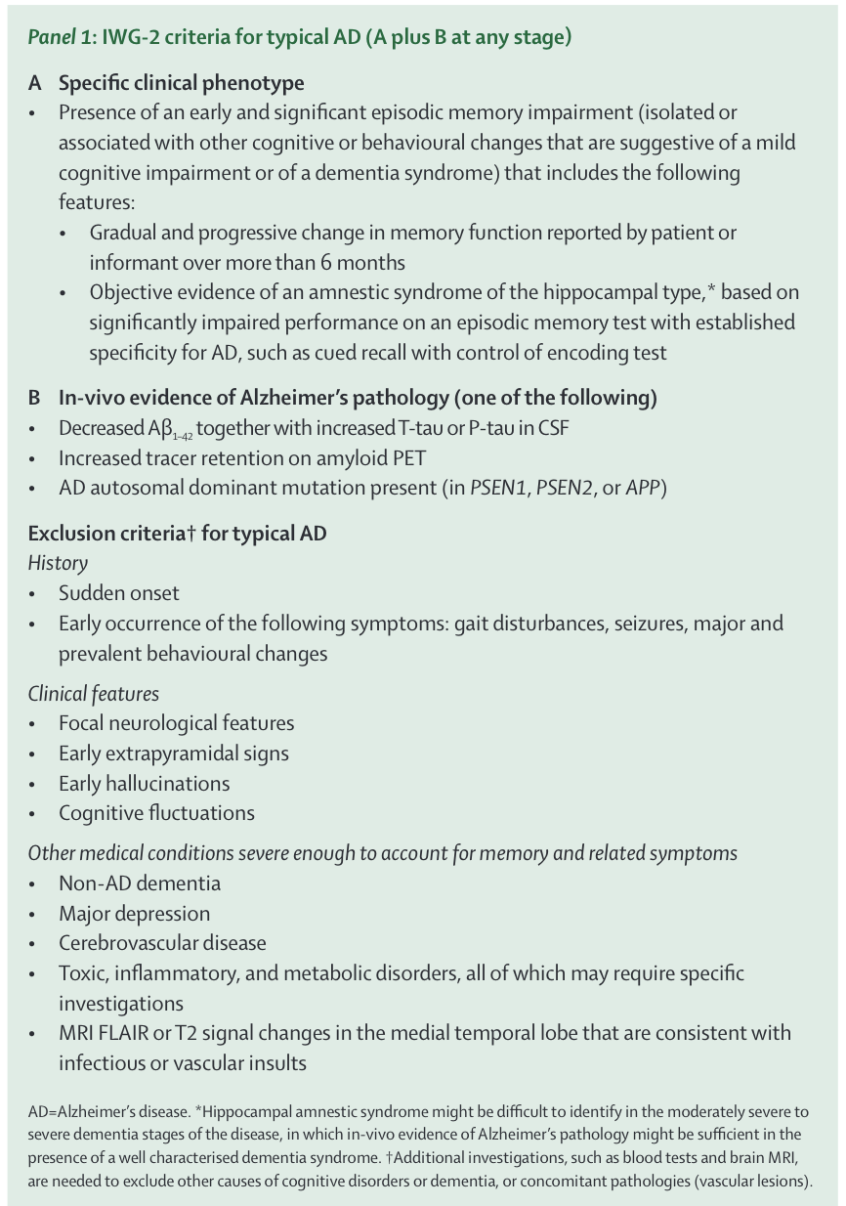
Discussion
1. Competing risk
2. Antihypertensive drugs
The Lancet Neurology 2007 Vol. 6 Issue 8 Pages 734-746

